Slide 1
Cloud compute and network communications
Client to Cloud
Note: presentation has Animations. See it as Slide Show.

Slide 2
Cloud Computing and Network Communications
A main use of the cloud is to run applications on a compute platform.
Network communications are required to gain access to such applications.
Also, network communications is required for the deployment, maintenance, upgrading and supervision of the compute resources.
A common problem that persists in organizations moving their applications to the cloud is that the developers understand how to write applications, but when in comes to the architecting of the platform or accessing the resources, they have problems with the fundamentals of network communications.
This section is intended to cover such basics of network communications from a customer to the cloud perspective.

Slide 3
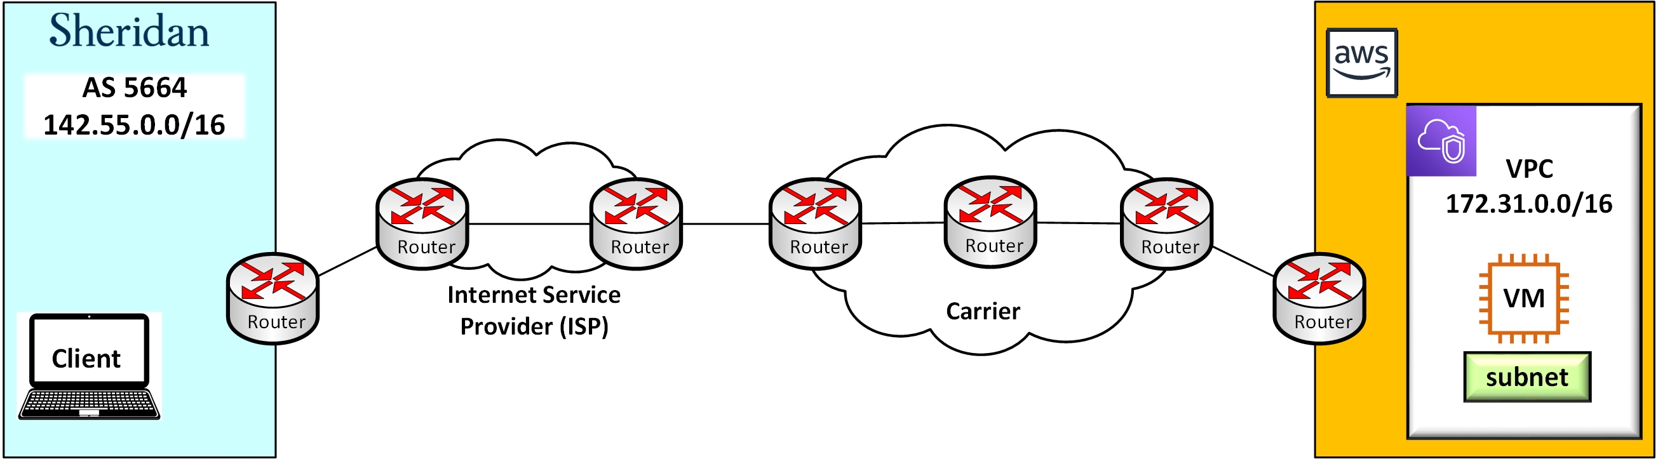
Internet traffic from customer to cloud
This diagram is a very simplified representation of a the connectivity between a customer’s organization and a cloud provider across the Internet.
On the left, the example organization is Sheridan College. To the right, it is AWS cloud. In between, there is an unspecified number of Internet companies that provide the interconnectivity.
Let’s assume that the client organization has compute resources both on-premises and in the public cloud.
This diagram will be used to explain the fundamentals of network communication between the College and AWS resources.

Slide 4
Internet traffic from customer to cloud
An Internet access provider such as Frontier Networks
https://hellofrontiernetworks.com/
An large Internet carrier such as ATT, Verizon, etc. For example.
A Cloud Provider, any.
Super simplified view of Sheridan’s network domain.

Slide 5


Routing domain
Sheridan College has its own “routing domain”.
This is a network under the administrative control of the IT department of the College.
It is an Internet Autonomous System (AS).
This domain is identified with a unique number to the rest of the Internet, the AS number 5664.
This domain owns a public IPv4 address block which is 142.55.0.0/16.
All the IPv4 addresses that begin with 142.55 belong to Sheridan College.
Sheridan advertises the block 142.55.0.0/16 to its Internet provider.
Note: there are 65,536 public addresses in this block.
Autonomous System AS 5664
IPv4 address space 142.55.0.0/16
HMC
142.55.0.0/16
is here
Davis
Trafalgar

Slide 6

Routing knowledge propagates
AS 5664
142.55.0.0/16
Internet Access Provider
AS 5664 owns 142.55.0.0/16
Router in HMC Campus
BGP
From its Mississauga main border router, Sheridan College advertises its address space 142.55.0.0/16 to its Internet Access Provider (Frontier Network communications as for December 2022).
Frontier adds that information to its routing table and from there it further propagates the knowledge to its upstream connections.
The routing protocol BGP is used to propagate the knowledge.
client

Slide 7
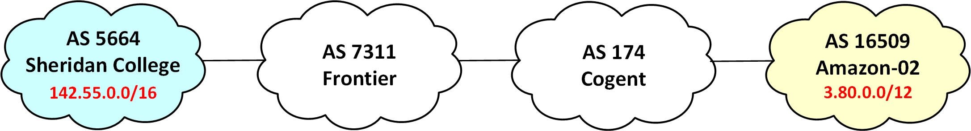
Routing knowledge propagates
Frontier learns from Sheridan the location of all the 142.55 addresses.
Frontier tells other Internet companies such as Cogent Communications.
Eventually, the knowledge propagates to reach remote locations such as AWS’ Autonomous System 16509.
https://www.cogentco.com/en/
https://hellofrontiernetworks.com/

Slide 8
Routing knowledge propagates
Internet Company
AS 16509 owns 3.80.0.0/12
AWS
AS 16509
3.80.0.0/12
BGP
Coming from the other side, the same situation occurs.
AWS, Azure, Google Cloud, etc; they also advertise their autonomous systems IP address spaces.
The Internet functions on the principle that the routing protocol BGP advertises the location of the public networks.

Slide 9
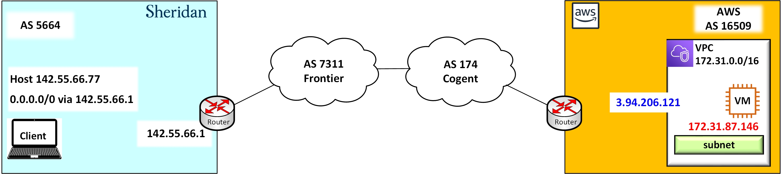
Customer side – Internet – Cloud side
Let’s add some details to the diagram once that the general network communications principle has been outlined.
Let’s assume that there is a customer, a student, sitting inside Sheridan College.
This customer has an account in AWS which provides a virtual network space (The Virtual Private Cloud or VPC) where to deploy compute and network resources.

Slide 10




Cloud perspective
The customer has an account in the AWS cloud. This enables a virtual space where to deploy resources.
A default VPC.
Subnets with public access.
Virtual machines.
Connection to subnets.
A private IPv4 address.
A public IPv4 address.
A routing table.
An Internet Gateway.
My-default-VPC
Region
us-east-1
Public Subnet
172.31.0.0/16
EC2 Instance
0.0.0.0 / 0
Route table
Public address
3.94.206.121
Private address
172.31.87.146
VPC’s Gateway
Subnet 172.31.80.0/20

Slide 11
Traffic delivery
Region us-east-1
My-default-VPC
EC2 Instance
webserver
Public address
3.94.206.121
Private address
172.31.87.146
client
Subnet 172.31.80.0/20
IPv4 142.55.66.77
Internet Provider
This is a simplified diagram to explain how information is exchanged between a customer’s PC and a webserver deployed in an EC2 instance in AWS.
The PC (at Sheridan) has been assigned the IPv4 address 142.55.66.77.
The webserver(at AWS) has been assigned the IPv4 address 3.04.206.121.

Slide 12
Traffic delivery
Region us-east-1
My-default-VPC
EC2 Instance
webserver
Destination MAC
Source MAC
Public address
3.94.206.121
Private address
172.31.87.146
client
Subnet 172.31.80.0/20
IPv4 142.55.66.77
Internet Provider
The customer is testing the functioning of the webserver.
The customer PC sends an HTTP request to the webserver.
The PC makes a message encapsulated in layers.
The lowest layer of the encapsulation contains the destination MAC address and the source MAC address.
The lowest layer of the encapsulation is an Ethernet frame.

Slide 13
Traffic delivery
Region us-east-1
My-default-VPC
EC2 Instance
Default Gateway Router
webserver
Destination MAC
Source MAC
Public address
3.94.206.121
Private address
172.31.87.146
client
Subnet 172.31.80.0/20
IPv4 142.55.66.77
Internet Provider
The destination MAC address is on the next device’s interface.
In this example, the address of the interface of the default gateway router.
The intention is to forward the data to the next physical hop (the router in this example).

Slide 14
Traffic delivery
Region us-east-1
My-default-VPC
Source IP 142.55.66.77
Destination IP 3.94.206.121
EC2 Instance
webserver
Destination MAC
Source MAC
Public address
3.94.206.121
Private address
172.31.87.146
client
Subnet 172.31.80.0/20
IPv4 142.55.66.77
Internet Provider
The Ethernet frame contains an IPv4 packet.
The Ethernet protocol encapsulates an IP protocol packet.
This packet contains the destination IP address (the webserver’s 3.94.206.121).
This packet also contains the source IP address (the PC’s IP address)

Slide 15
Traffic delivery
Region us-east-1
Source port ephemeral #
Destination port 80 (HTTP)
My-default-VPC
Source IP 142.55.66.77
Destination IP 3.94.206.121
EC2 Instance
webserver
Destination MAC
Source MAC
Public address
3.94.206.121
Private address
172.31.87.146
client
Subnet 172.31.80.0/20
IPv4 142.55.66.77
Internet Provider
The IPv4 packet encapsulates a TCP segment.
The TCP header contains the destination port that the webserver listens on.
The unique number 80 is reserved for the HTTP protocol.
The webserver listens to TCP web protocol sessions.

Slide 16
Traffic delivery
HTTP (GET)
Region us-east-1
Source port ephemeral #
Destination port 80 (HTTP)
My-default-VPC
Source IP 142.55.66.77
Destination IP 3.94.206.121
EC2 Instance
webserver
Destination MAC
Source MAC
Public address
3.94.206.121
Private address
172.31.87.146
client
Subnet 172.31.80.0/20
IPv4 142.55.66.77
Internet Provider
Finally, the TCP segment encapsulates an HTTP message (GET in this example).
HTTP is the protocol used to exchange messages with a web application.
HTTP = Hypertext Transfer Protocol
The HTTP message data needs to be delivered across the Internet to the cloud VPC.

Slide 17
Traffic delivery
HTTP (GET)
Region us-east-1
Source port ephemeral #
Destination port 80 (HTTP)
My-default-VPC
Source IP 142.55.66.77
Destination IP 3.94.206.121
EC2 Instance
webserver
Destination MAC
Source MAC
Public address
3.94.206.121
Private address
172.31.87.146
client
Subnet 172.31.80.0/20
IPv4 142.55.66.77
Internet Provider
First, all the encapsulated data is forwarded to the next physical hop.
It depends on the network topology. In this example, that is the default border router.
The Ethernet frame encapsulates everything else. It has the MAC addresses too.
The router receives the frame because it is directed to its interface’s MAC address.

Slide 18
Traffic delivery
HTTP (GET)
Region us-east-1
Source port ephemeral #
Destination port 80 (HTTP)
My-default-VPC
Source IP 142.55.66.77
Destination IP 3.94.206.121
EC2 Instance
webserver
Destination MAC
Source MAC
Route table
3.80.0.0/12
Public address
3.94.206.121
Private address
172.31.87.146
client
Subnet 172.31.80.0/20
IPv4 142.55.66.77
Internet Provider
The router receives the data, it removes the Ethernet frame, and it reads the destination IP address.
Then, it reads its routing table. (This is called route look up).
It finds that the host address 3.94.206.121 is inside network 3.80.0.0/12.
This knowledge was obtained by talking BGP with the Internet provider.
So, it knows where to forward the data.

Slide 19
Traffic delivery
HTTP (GET)
Region us-east-1
Source port ephemeral #
Destination port 80 (HTTP)
My-default-VPC
Source IP 142.55.66.77
Destination IP 3.94.206.121
EC2 Instance
webserver
Destination MAC
Source MAC
Public address
3.94.206.121
Private address
172.31.87.146
client
Subnet 172.31.80.0/20
IPv4 142.55.66.77
Internet Provider
The router creates a new Ethernet frame (or any layer 2 protocol used in the interfaces).
Sourced from its local interface to the destination MAC address of the next hop.

Slide 20
Traffic delivery
HTTP (GET)
Region us-east-1
Source port ephemeral #
Destination port 80 (HTTP)
My-default-VPC
Source IP 142.55.66.77
Destination IP 3.94.206.121
EC2 Instance
webserver
Destination MAC
Source MAC
Public address
3.94.206.121
Private address
172.31.87.146
client
Subnet 172.31.80.0/20
IPv4 142.55.66.77
Internet Provider
It forwards the frame with all the encapsulated data to the next hop.

Slide 21
Traffic delivery
HTTP (GET)
Region us-east-1
Source port ephemeral #
Destination port 80 (HTTP)
My-default-VPC
Source IP 142.55.66.77
Destination IP 3.94.206.121
EC2 Instance
webserver
Destination MAC
Source MAC
Public address
3.94.206.121
Private address
172.31.87.146
client
Subnet 172.31.80.0/20
Route table
IPv4 142.55.66.77
3.80.0.0/12
The next router receives the data, it removes the Ethernet frame, and it reads the destination IP address.
Then, it reads its routing table.
It finds that the host address 3.94.206.121 is inside network 3.80.0.0/12.
So, it knows where to forward the data.

Slide 22
Traffic delivery
HTTP (GET)
Region us-east-1
Source port ephemeral #
Destination port 80 (HTTP)
My-default-VPC
Source IP 142.55.66.77
Destination IP 3.94.206.121
EC2 Instance
webserver
Destination MAC
Source MAC
Public address
3.94.206.121
Private address
172.31.87.146
client
Subnet 172.31.80.0/20
IPv4 142.55.66.77
Internet Provider
The router creates a new Ethernet frame (or any layer 2 protocol used in the interfaces).
Sourced from its local interface to the destination MAC address of the next hop.

Slide 23
Traffic delivery
HTTP (GET)
Region us-east-1
Source port ephemeral #
Destination port 80 (HTTP)
My-default-VPC
Source IP 142.55.66.77
Destination IP 3.94.206.121
EC2 Instance
webserver
Destination MAC
Source MAC
Public address
3.94.206.121
Private address
172.31.87.146
client
Subnet 172.31.80.0/20
IPv4 142.55.66.77
Internet Provider
It forwards the frame with all the encapsulated data to the next hop.

Slide 24
Traffic delivery
HTTP (GET)
Region us-east-1
Source port ephemeral #
Destination port 80 (HTTP)
My-default-VPC
Source IP 142.55.66.77
Destination IP 3.94.206.121
EC2 Instance
webserver
Destination MAC
Source MAC
Public address
3.94.206.121
Private address
172.31.87.146
client
Subnet 172.31.80.0/20
Route table
IPv4 142.55.66.77
3.80.0.0/12
The next router receives the data, it removes the Ethernet frame, and it reads the destination IP address.
Then, it reads its routing table.
It finds that the host address 3.94.206.121 is inside network 3.80.0.0/12.
So, it knows where to forward the data (the next hop).

Slide 25
Traffic delivery
HTTP (GET)
Region us-east-1
Source port ephemeral #
Destination port 80 (HTTP)
My-default-VPC
Source IP 142.55.66.77
Destination IP 3.94.206.121
EC2 Instance
webserver
Destination MAC
Source MAC
Public address
3.94.206.121
Private address
172.31.87.146
client
Subnet 172.31.80.0/20
IPv4 142.55.66.77
Internet Provider
It forwards the frame with all the encapsulated data to the next hop.

Slide 26

Traffic delivery
Region us-east-1
My-default-VPC
EC2 Instance
The data arrives at the customer’s VPC in the cloud.
It must pass through a first security filter, the NACL.
Then, it must pass through a second security filter, the security group.
webserver
HTTP
Public address
3.94.206.121
Private address
172.31.87.146
TCP
Security Group
in
IPv4
Ethernet
ssh
http
else
Responses
Updates
Network
Access
Control List
out
Subnet 172.31.80.0/20

Slide 27
Traffic delivery
Region us-east-1
My-default-VPC
In this example, the NACL is set to allow all traffic that is coming from the Internet.
Hence, the data can continue.
The security group has two inbound rules:
1) allow SSH,
2) allow HTTP
The second rule is a match, so the traffic is allowed to continue toward the EC2 instance.
EC2 Instance
webserver
HTTP
Public address
3.94.206.121
Private address
172.31.87.146
TCP
in
IPv4
Ethernet
ssh
http
else
Security
Group
Responses
Updates
Network
Access
Control List
out
Subnet 172.31.80.0/20

Slide 28
Traffic delivery
Region us-east-1
My-default-VPC
EC2 Instance
webserver
The data finally arrives to the destination.
HTTP
Public address
3.94.206.121
Private address
172.31.87.146
TCP
IPv4
Ethernet
SG allow HTTP
Subnet 172.31.80.0/20

Slide 29
Traffic delivery
The data finally arrives to its destination (the webserver).
The webserver removes the frame.
It reads the IP packet. It saves the source IP address (to reply back).
The TCP destination port (80) prompts a call to the application HTTP server.
The web server socket receives the HTTP message (GET)
Region us-east-1
My-default-VPC
EC2 Instance
webserver
HTTP
TCP
IPv4
Ethernet
SG allow HTTP
Subnet 172.31.80.0/20

Slide 30
Traffic reply
The web server prepares the response to the client.
This response is formatted in a Hyper Text Transfer Protocol (HTTP) message.
The HTTP message must be encapsulated inside a transport segment provided by the Transmission Control Protocol (TCP).
All this data must be carried inside the payload of an Internet Protocol (IP) packet.
Finally, the data must start the voyage back by reaching the next hop device. This is achieved with an Ethernet protocol frame.
Region us-east-1
My-default-VPC
EC2 Instance
webserver
HTTP
TCP
IPv4
Ethernet
SG allow HTTP
Subnet 172.31.80.0/20

Slide 31
Traffic delivery
Region us-east-1
My-default-VPC
Going outbound, the data must pass through the security group filter.
The security group has one rule that allows all traffic going out such as responses and update requests.
Hence the traffic can continue.
EC2 Instance
webserver
HTTP
TCP
IPv4
Ethernet
in
ssh
http
else
Security
Group
Responses
Updates
Network
Access
Control List
out
Subnet 172.31.80.0/20

Slide 32
Traffic delivery
Region us-east-1
My-default-VPC
Going outbound, the data must pass through the Network Access Control List (NACL) filter.
The NACL is set to allow all traffic going outbound.
Hence the traffic can continue.
EC2 Instance
webserver
HTTP
TCP
in
IPv4
Ethernet
ssh
http
else
Security
Group
Responses
Updates
Network
Access
Control List
out
Subnet 172.31.80.0/20

Slide 33
Traffic delivery
Region us-east-1
Routing decisions must be made for the data to continue to the customer.
The routing principles are the same everywhere: a) read the destination IP address (142.55.66.77), b) find a match, c) forward.
To make routing decisions, the VPC subnets are ruled by a Route Table controlled by a virtual router.
The IP address 0.0.0.0/0 means “all the addresses” by convention.
It has a pointer toward the default gateway router (or Internet Gateway).
Consequently, all the traffic that is not bound internally to the VPC’s 172.31.0.0/16 is sent to the Internet by default.
My-default-VPC
EC2 Instance
Route table
172.31.0.0/16
webserver
0.0.0.0 / 0
HTTP
Default exit
TCP
in
IPv4
Ethernet
ssh
http
else
Security
Group
Responses
Updates
Internet Gateway
Network
Access
Control List
out
Subnet 172.31.80.0/20

Slide 34
Traffic delivery
HTTP (GET)
Region us-east-1
Source port
80 (HTTP)
Destination port ephemeral
My-default-VPC
Source IP
3.94.206.121 Destination IP 142.55.66.77
EC2 Instance
webserver
Destination MAC
Source MAC
Public address
3.94.206.121
Private address
172.31.87.146
client
Subnet 172.31.80.0/20
IPv4 142.55.66.77
Internet Provider
The data is on the Internet Gateway (a router) now.
Notice that the TCP source port is HTTP (the server’s port 80) and that the destination port is the ephemeral (temporal) number from where the client PC started the conversation.
Notice also that the destination IPv4 address is 142.55.66.77 and that the source IPv4 address is the webserver’s public IPv4 address 3.94.206.121.

Slide 35
Traffic delivery
HTTP (GET)
Region us-east-1
Source port
80 (HTTP)
Destination port ephemeral
My-default-VPC
Source IP
3.94.206.121 Destination IP 142.55.66.77
EC2 Instance
webserver
Destination MAC
Source MAC
Public address
3.94.206.121
Private address
172.31.87.146
client
Subnet 172.31.80.0/20
IPv4 142.55.66.77
Internet Provider
The data is on the way back now.
It reaches the neighbour router in an Internet carrier.
The router proceeds to perform the standard routing decision operation: a) read the destination IPv4 address, b) look up the routing table, c) if there is a match, make a forwarding decision.

Slide 36
Traffic delivery
HTTP (GET)
Region us-east-1
Source port
80 (HTTP)
Destination port ephemeral
My-default-VPC
Source IP
3.94.206.121 Destination IP 142.55.66.77
EC2 Instance
webserver
Destination MAC
Source MAC
Public address
3.94.206.121
Private address
172.31.87.146
client
Subnet 172.31.80.0/20
IPv4 142.55.66.77
Internet Provider
Every router in the path repeats the same process until reaching the final destination.

Slide 37
Traffic delivery
HTTP (GET)
Region us-east-1
Source port
80 (HTTP)
Destination port ephemeral
My-default-VPC
Source IP
3.94.206.121 Destination IP 142.55.66.77
EC2 Instance
webserver
Destination MAC
Source MAC
Public address
3.94.206.121
Private address
172.31.87.146
client
Subnet 172.31.80.0/20
IPv4 142.55.66.77
Internet Provider
Every router in the path repeats the same process until reaching the final destination.

Slide 38
Traffic delivery
HTTP (GET)
Region us-east-1
Source port
80 (HTTP)
Destination port ephemeral
My-default-VPC
Source IP
3.94.206.121 Destination IP 142.55.66.77
EC2 Instance
webserver
Destination MAC
Source MAC
Public address
3.94.206.121
Private address
172.31.87.146
client
Subnet 172.31.80.0/20
IPv4 142.55.66.77
Internet Provider
Every router in the path repeats the same process until reaching the final destination.

Slide 39
Different customer scenario
The client is now in a home network

Slide 40
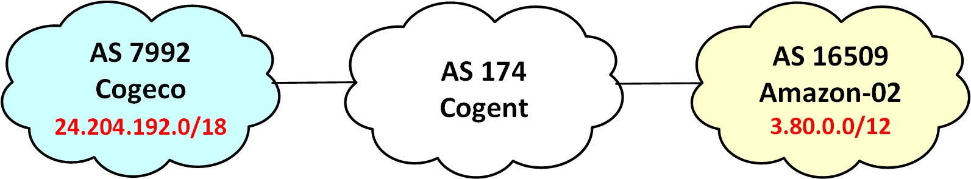
Customer is at home
This is a typical case of an administrator sitting at home. This case will be use to illustrate some networking principles.
The customer is connected to network 24.204.192.0/18 which belongs to AS 7992, Cogeco networks.
To get to AWS, the traffic must go across Cogeco network, then across the Cogent carrier.

Slide 41
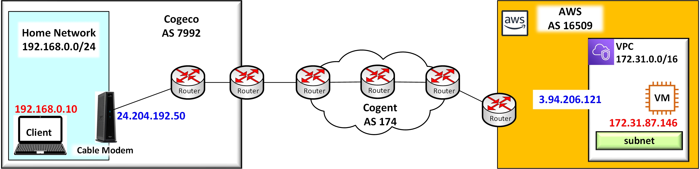
Customer at home network
This is a simplified take on the network path. In reality, there must be dozens of devices in the path.
The customer is technically part of the Internet provider network.
The customer receives one public address (24.204.192.50) that belongs to Cogeco and it is assigned to the cable modem external interface.

Slide 42
Analogy between the home network and the cloud network.
Notice the analogy between the customer at home and the customer virtual space in AWS. Let’s compare both networks.
The home network of the customer has one public IPv4 address supplied by Cogeco (24.204.192.50).
Internally, the home network has a private address space 192.168.0.0/24.

Slide 43
Analogy between the home network and the cloud network.
The resources deployed in AWS can receive public IPv4 addresses supplied by AWS (this is optional).
The customer virtual network (VPC) has a private address space 172.16.0.0/12 from where subnets are created and addresses are assigned to resources.
This is the analogy, in principle, what it is implemented in the home network is also implemented in the cloud. Similar concepts, the details differ though.

Slide 44
Definition public and private IPv4 addresses
Public IPv4 addresses:
Unique address assigned to organizations by the Internet Assigned Number Authority IANA.
These unique address are advertised to the rest of the Internet so they are globally reachable.
Public addresses are required for packets to travel across the Internet.
Sheridan owns the block from 142.55.0.0 to 142.55.255.255 represented by 142.55.0.0/16.
Private IPv4 addresses:
Addresses that can be used by everyone.
Because they are not uniquely assigned, they can not be advertised by anyone.
They are not owned by anyone.
These are private ranges:
192.168.0.0/16
172.16.0.0/12
10.0.0.0/8
100.64.0.0/10

Slide 45

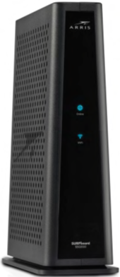
Home network
The most fundamental component of a home network is the cable modem.
This is a device serving several applications:
An interface between the home network and the cable provider network.
A translator between private-public addresses.
A DHCP server (it supplies all the IP address information)
A basic default router.
A basic firewall.
A DNS relay.
A Wi-Fi LAN access point.
Home network
private IPv4 space
192.168.0.0/24
F
I
R
E
W
A
L
L
inside
outside
IPv4 Public
24.204.192.50
Default exit
Your address info
What is www?
Cable Modem
client
IPv4 host 192.168.0.10/24

Slide 46
Home network
The DHCP service provides a critical service.
Let’s assume that the PC is just powering on.
Once that the client computer boots up, it starts sending broadcast messages directed to the port of the DHCP server in the LAN.
(The client computer is initially clueless, so it start yelling asking for DHCP help).
The DHCP server replies with all the information needed to interoperate in the Local Area Network.
The host IP address for the PC.
The default gateway router IP address.
The location of the DNS relay to resolve names to IP addresses.
DHCP server:
This is your host address 192.168.0.10
You are in network 192.168.0.0/24
Your default gateway is 192.168.0.1
Your DNS relay is 192.168.0.1
Here, your address info
Cable Modem
DHCP help me out
client

Slide 47
The cloud side
Region us-east-1
Now, let’s move to the cloud side. Is there an analogy?
There is a private space that the customer “owns”.
Virtual computers can be deployed in such space.
These instances always receive a private IPv4 host address from a internal DHCP service.
Optionally, public IP address can be assigned to the instances.
There is a default gateway router too.
So, there are analogies between the home and the cloud scenarios.
That is because the fundamentals are the same.
My-default-VPC
IPv4 172.31.0.0/16
EC2 Instance
webserver
Public address
3.94.206.121
Private address
172.31.87.146
Subnet 172.31.80.0/20

Slide 48
Home network
The cable modem performs another function that has an equivalency in the cloud.
It is a critical function for the home network.
All home network cable modems are assigned one public IPv4 address to the external interface.
The public IPv4 address space has been depleted. There are not enough for all the existing devices.
Internally, the home network uses a private IPv4 address space.
The PC client obtains one of the addresses from such private space.
The IP packets originate with such source private address.
Home network
private IPv4 space
192.168.0.0/24
HTTP
inside
outside
Source port
80 (HTTP)
Destination port ephemeral
Source IP
192.168.0.10
IPv4 Public
24.204.192.50
Destination IP 3.94.206.121
Destination MAC
Source MAC
Cable Modem
client
IPv4 host 192.168.0.10/24

Slide 49
Home network
Home network private IPv4 space
192.168.0.0/24
The IP packets originate with a source private address (192.168.0.10 in the example).
However, this address is not recognized outside the home network (because it is private precisely).
The Cable Modem performs a Network Address Translation (NAT) operation.
It replaces the private IPv4 (192.168.0.10) with the public IPv4 address (24.204.192.50).
HTTP
Source port
80 (HTTP)
Destination port ephemeral
Source IP
192.168.0.10
Destination IP 3.94.206.121
Destination MAC
Source MAC
inside
outside
client
IPv4 Public
24.204.192.50
IPv4 host 192.168.0.10/24
Cable Modem

Slide 50
Home network
The Cable Modem performs a Network Address Translation (NAT) operation.
It replaces the private IPv4 (192.168.0.10) with the public IPv4 address (24.204.192.50).
The NAT function maintains a state table to keep track of the sessions going out the home network, so it can take care of several computers at the same time.
From the view point of the destination service, the communication appears to be sourced from the public IPv4 address.
The NAT function acts as proxy for the communication.
Home network private IPv4 space
192.168.0.0/24
HTTP
Source port
80 (HTTP)
Destination port ephemeral
Source IP
192.168.0.10
Source IP
24.204.192.50
Destination IP 3.94.206.121
Destination MAC
Source MAC
inside
outside
client
IPv4 Public
24.204.192.50
IPv4 host 192.168.0.10/24
Cable Modem

Slide 51
The cloud side
Region us-east-1
Now, let’s move to the cloud side. Is there an analogy?
A compute resource always have an internal private address by default.
Having a public address is an option.
Is there NAT translation in this case?
Even though the principle is the same, to provide Internet reachability, it is unclear how AWS implements this function. This is not something that it is published anywhere.
Does AWS assigns the public address directly to the EC2 instance?
We can only guess in this case.
My-default-VPC
IPv4 172.31.0.0/16
EC2 Instance
webserver
Public address
3.94.206.121
Private address
172.31.87.146
Subnet 172.31.80.0/20

Slide 52
The fundamentals (get them right)
The fundamentals are critical to:
understand,
to deploy,
to design,
to architect,
to troubleshoot
cloud resources.
If your fundamental knowledge is in place, then you can build on to of them to become a better professional.

Slide 53
Exploring the Cloud network
From within the VPC

Slide 54
Exploring and understanding the cloud environment
Create an EC2 instance.
Allow access via SSH.
Grab the public IPv4 address.
SSH into the EC2 instance.
Run the following commands (next slide)

Slide 55
Run the following commands
ip addr
arp –a
route
traceroute 8.8.8.8
traceroute www.sheridancollege.ca
dig www.sheridancollege.ca
dig www.google.com
cat /var/lib/dhclient/dhclient--eth0.lease

Slide 56
ip addr
This command should show the interfaces of the EC2 instance.
It shows the details of the interface network configuration.
What information can you glean from this command? Specify.

Slide 57
[ec2-user@ip-172-31-93-229 ~]$ ip addr
1: lo: <LOOPBACK,UP,LOWER_UP>
mtu 65536
state UNKNOWN group
link/loopback 00:00:00:00:00:00
brd 00:00:00:00:00:00
inet 127.0.0.1/8 scope host lo
inet6 ::1/128 scope host
2: eth0: <BROADCAST,MULTICAST,UP,LOWER_UP>
mtu 9001
state UP
link/ether 12:03:83:6d:4a:cf
brd ff:ff:ff:ff:ff:ff
inet 172.31.93.229/20
brd 172.31.95.255
scope global dynamic eth0
EC2
Instance
The EC2 instance has a loopback interface with the standard loopback address 127.0.0.1.
It has an ethernet 0 interface with the assigned private address 172.31.93.229/20.

Slide 58
arp -a
This command should show the ARP table of the EC2 instance.
Any computer needs to know the MAC address of the next hop device.
What is the MAC address and IPv4 address that this EC2 instance knows according to the ARP table?

Slide 59
[ec2-user@ip-172-31-93-229 ~]$ arp -a
instance-data.ec2.internal (169.254.169.254) at 12:17:8f:72:2f:b7 [ethernet] on eth0
ip-172-31-80-1.ec2.internal (172.31.80.1) at 12:17:8f:72:2f:b7 [ethernet] on eth0
This is the ARP (Address Resolution Protocol) table of the EC2 instance.
This is the knowledge about IP and MAC address correlation that the EC2 instance has.
The EC2 knows the mapping of two IPv4 addresses with two MAC addresses.
The special address 169.254.169.254 is used to retrieve user data and instance metadata in the AWS cloud.
The IP address 172.31.80.1 is the virtual default router address.
Notice that the two IPv4 addresses map onto the same MAC address 12:17:8f:72:2f:b7.
So, the same resource answers for two different services.

Slide 60
arp -a
EC2
Instance
The EC2 instance knows the IPv4 address and the MAC address of the default virtual router.
Eth0
IPv4 address
172.31.93.229/20
MAC address 12:03:83:6d:4a:cf
Subnet 172.31.80.0/20
IPv4 address 172.31.80.1
MAC address 12:17:8f:72:2f:b7

Slide 61
[ec2-user@ip-172-31-93-229 ~]$ route
This command shows the EC2 instance routing table.
This is a basic routing table with a default route pointing toward the default gateway router 172.31.80.1 of the subnet.
Kernel IP routing table
Destination | Gateway | Mask | Metric | Interface
default | ip-172-31-80-1 | 0.0.0.0 | 0 | eth0
instance-date.e | 0.0.0.0 | 255.255.255.255 | 0 | eth0
172.31.80.0 | 0.0.0.0 | 255.255.240.0 | 0 | eth0

Slide 62
[ec2-user@ip-172-31-93-229 ~]$ dig www.sheridancollege.ca
The dig (domain information groper) command is a tool for asking DNS name servers.
It performs DNS lookups and displays the answers.
For example, in this case, the question was who owns www.sheridancollege.ca (who answers for this domain name?)
The DNS server who is the authority for Sheridan names is at 142.55.47.60.
Notice the entry SERVER 172.31.0.2#53.
This is the local DNS server that responds to all the queries from within the customer VPC.
(Edited for simplicity)
DiG 9.11.4-P2-RedHat-9.11.4-26.P2.amzn2.5.2 <<>> www.sheridancollege.ca
;; QUESTION SECTION:
;www.sheridancollege.ca. IN A
;; ANSWER SECTION:
www.sheridancollege.ca. 30 IN CNAME www.dyn.sheridancollege.ca.
www.dyn.sheridancollege.ca. 30 IN A 142.55.47.60
;; SERVER: 172.31.0.2#53 (172.31.0.2)

Slide 63
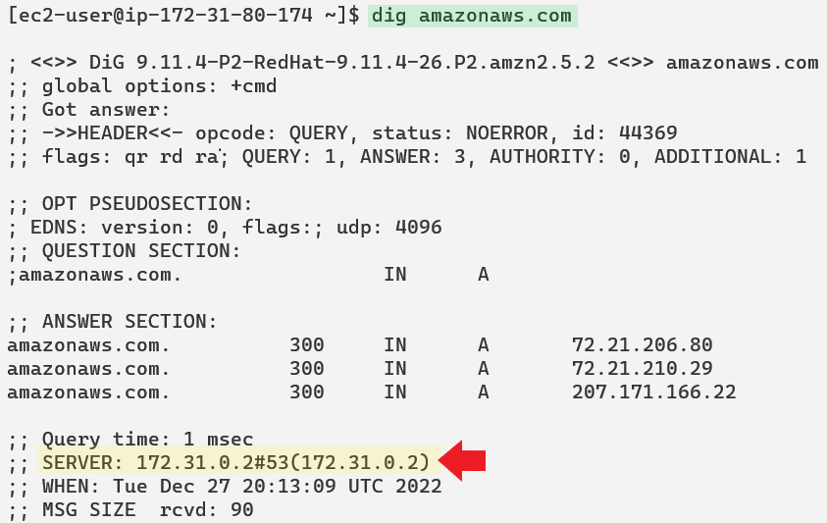
dig amazonaws.com
This command returns the public IPv4 addresses of the three servers responsible for the name zone.
The local DNS server that responded the query is 172.31.0.2 on UDP port 53.

Slide 64
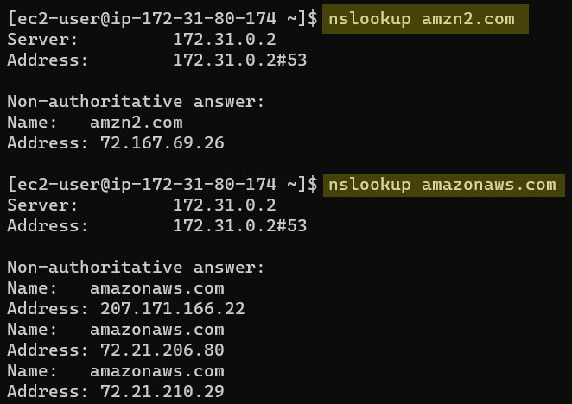
nslookup and dig
The DNS domain amz2.com and amazonaws.com belong to AWS.
The command nslookup issues a query to be answered by a local DNS, if there is any.
And there is, 172.31.0.2 replies back.
The origin of the information is in the Authoritative servers though.

Slide 65
dig www.sheridancollege.ca
EC2
Instance
The output of the command dig has revealed that there is a local (AWS) DNS server at 172.31.0.2.
This address is always reserved to the local DNS server.
This is the DNS server used when the EC2 instance needs to resolve a DNS name to an IP address.
The DNS protocol is reachable at the UDP port number 53.
Port 53 is reserved for DNS.
dig www.sheridancollege.ca
Query: where is this domain?
172.31.0.1
Subnet 172.31.80.0/20
Answer: that domain can be found at 142.55.47.60.
172.31.0.2
UDP port 53
Local DNS server

Slide 66
cd /var/lib/dhclient/ cat dhclient--eth0.lease
lease {
interface "eth0";
fixed-address 172.31.93.229;
option subnet-mask 255.255.240.0;
option routers 172.31.80.1;
option dhcp-lease-time 3600;
option domain-name-servers 172.31.0.2;
option dhcp-server-identifier 172.31.80.1;
option interface MTU 9001 bytes;
option broadcast-address 172.31.95.255;
option host-name "ip-172-31-93-229";
option domain-name "ec2.internal";
This command shows all the information pertaining to the DHCP service.
The answer has been edited for clarity.
The EC2 instance has received on interface eth0 all this information from the DHCP server.
A fixed IPv4 private address 172.31.93.229/20.
The location of the router at 172.31.80.1.
The location of the DNS server at 172.31.80.2.
The location of the DHCP server at 172.31.80.1.
Notice that the address of the default router and the address of the DHCP server are the same. So, this is similar to the configuration of a cable modem in a home network.

Slide 67
[ec2-user@ip-172-31-93-229 ~]$ traceroute 8.8.8.8
Edited for clarity
216.182.224.188
216.182.238.199
216.182.226.238
100.66.12.34
100.66.12.228
100.65.74.112
100.66.40.58
100.66.14.6
100.66.14.156 4
241.0.4.145
100.66.47.224
241.0.5.13
240.0.28.27
241.0.5.6
240.0.44.27
240.0.44.17
240.0.28.31
240.0.28.22
242.0.147.49
242.0.146.49
240.0.28.27
52.93.28.203
242.0.179.33
52.93.28.237
52.93.28.233
100.100.36.44
100.100.34.32
100.100.34.84
100.100.4.94
99.83.65.1
108.170.246.33
108.170.232.213
dns.google
These are the addresses of the interfaces of the devices that were passed through by the data sent from the EC2 instance to the address 8.8.8.8 located in Google.

Slide 68
Retrieve data from 169.254.169.254
This address is a Link Local address which is used to retrieve metadata.
Link Local means that is only usable by the computer connected to the local link.
This is a useful address to collect information about the EC2 instance.
Continue…

Slide 69
Use curl http://169.254.169.254/latest/metadata
What is the instance type?
What is the operating system id?
What is the microprocessor?
What is the identification string of the instance?
Where is the instance located regarding availabilty zone?
What is the availability zone id?
What is the security group applied to the instance?
What is the public IPv4 address of the instance?
What is the private IPv4 address of the instance?
What is the MAC address of the interface?
What is the hostname of the instance?
What is the private DNS name of the instance?
What is the public DNS name of the instance?

Slide 70
curl http://169.254.169.254/latest/meta-data/
curl http://169.254.169.254/latest/meta-data/instance-type
curl http://169.254.169.254/latest/meta-data/ami-id
curl http://169.254.169.254/latest/meta-data/system
curl http://169.254.169.254/latest/meta-data/instance-id
curl http://169.254.169.254/latest/meta-data/placement/availability-zone
curl http://169.254.169.254/latest/meta-data/placement/availability-zone-id
curl http://169.254.169.254/latest/meta-data/placement/security-group
curl http://169.254.169.254/latest/meta-data/security-groups
curl http://169.254.169.254/latest/meta-data/public-ipv4
curl http://169.254.169.254/latest/meta-data/local-ipv4
curl http://169.254.169.254/latest/meta-data/network/interfaces/macs
curl http://169.254.169.254/latest/meta-data/mac
curl http://169.254.169.254/latest/meta-data/hostname
curl http://169.254.169.254/latest/meta-data/local-hostname
curl http://169.254.169.254/latest/meta-data/public-hostname

